Slide 1
Natural Language Processing

Slide 2
What is NLP
Natural Language Processing or NLP is a field of Artificial Intelligence that gives the machines the ability to read, understand and derive meaning from human languages.

Slide 3
Use cases for NLP
NLP enables the recognition and prediction of diseases based on electronic health records and patient’s own speech. This capability is being explored in health conditions that go from cardiovascular diseases to depression and even schizophrenia. For example, Amazon Comprehend Medical is a service that uses NLP to extract disease conditions, medications and treatment outcomes from patient notes, clinical trial reports and other electronic health records.
Organizations can determine what customers are saying about a service or product by identifying and extracting information in sources like social media. This sentiment analysis can provide a lot of information about customers choices and their decision drivers.
An inventor at IBM developed a cognitive assistant that works like a personalized search engine by learning all about you and then remind you of a name, a song, or anything you can’t remember the moment you need it to.
Companies like Yahoo and Google filter and classify your emails with NLP by analyzing text in emails that flow through their servers and stopping spam before they even enter your inbox.
To help identifying fake news, the NLP Group at MIT developed a new system to determine if a source is accurate or politically biased, detecting if a news source can be trusted or not.

Slide 4
Bag of Words
Is a commonly used model that allows you to count all words in a piece of text. Basically it creates an occurrence matrix for the sentence or document, disregarding grammar and word order. These word frequencies or occurrences are then used as features for training a classifier.
Term Frequency — Inverse Document Frequency” (TFIDF)

Slide 5
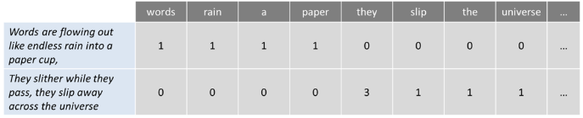
Example for Bag of Words
Ex. Words are flowing out like endless rain into a paper cup,
They slither while they pass, they slip away across the universe

Slide 6
Tokenization
Is the process of segmenting running text into sentences and words. In essence, it’s the task of cutting a text into pieces called tokens, and at the same time throwing away certain characters, such as punctuation.

Slide 7
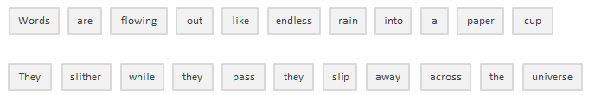

Slide 8
Stop Words
Includes getting rid of common language articles, pronouns and prepositions such as “and”, “the” or “to” in English. In this process some very common words that appear to provide little or no value to the NLP objective are filtered and excluded from the text to be processed, hence removing widespread and frequent terms that are not informative about the corresponding text.

Slide 9
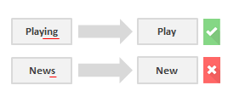
Stemming
Refers to the process of slicing the end or the beginning of
words with the intention of removing affixes (lexical additions to the root of the word).

Slide 10
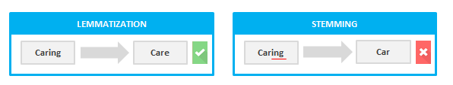
Lemmatization
Lemmatization resolves words to their dictionary form (known as lemma) f
or which it requires detailed dictionaries in which the algorithm can look into and link words to their corresponding lemmas.

Slide 11
Topic Modeling
Latent Dirichlet Allocation (LDA)
Unsupervised Learning
Is as a method for uncovering hidden structures in sets of texts or documents. In essence it clusters texts to discover latent topics based on their contents, processing individual words and assigning them values based on their distribution. This technique is based on the assumptions that each document consists of a mixture of topics and that each topic consists of a set of words, which means that if we can spot these hidden topics we can unlock the meaning of our texts.

Slide 12
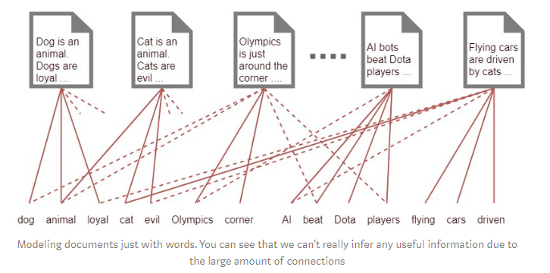

Slide 13
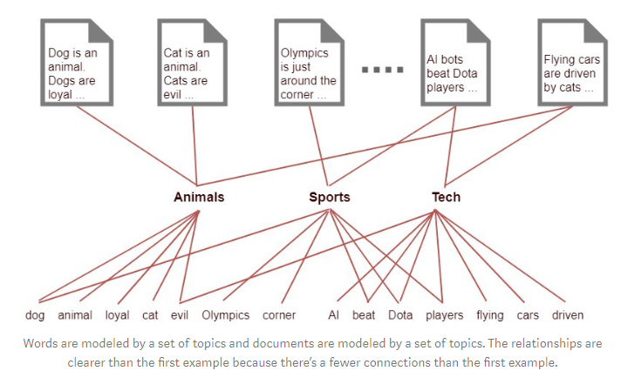

Slide 14
